Slide 1

An Introdution to CSS
By:
Mrs. Akbari , Mrs. Taheri, Mrs. Charoghi, Mrs. Norouzi, Mr. Karimzadeh, Mr. Roshannia

Slide 2


css
CSS stands for Cascading Style Sheets
CSS describes how HTML elements are to be displayed on screen, paper, or in other media
CSS saves a lot of work. It can control the layout of multiple web pages all at once
External stylesheets are stored in CSS files

Slide 3
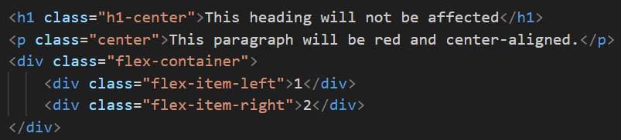
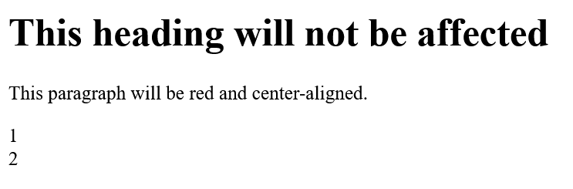
HTML document without applying CSS
html
css

Slide 4
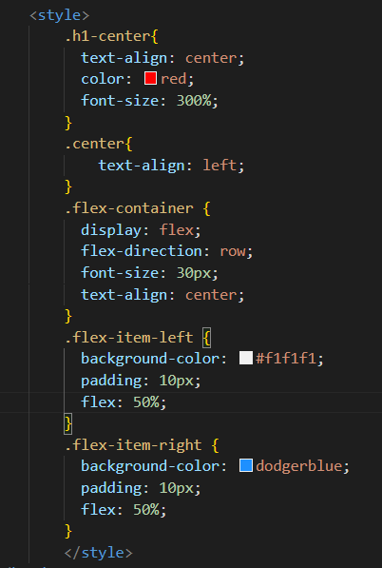

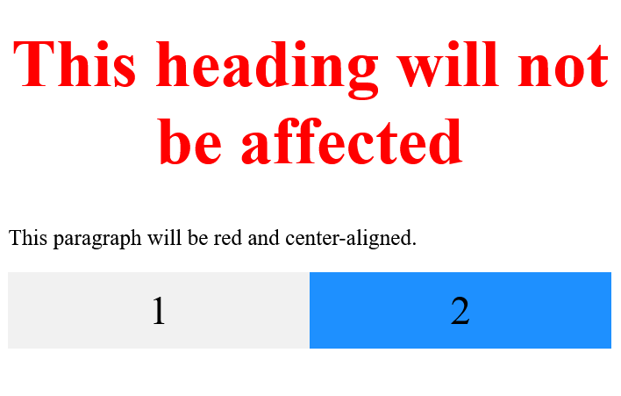
HTML document with applied CSS
html
css
output

Slide 5
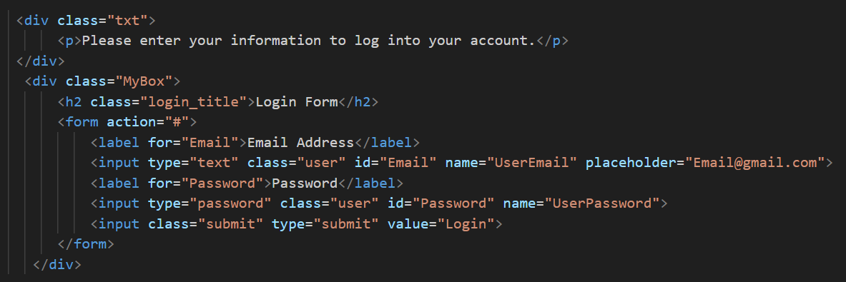
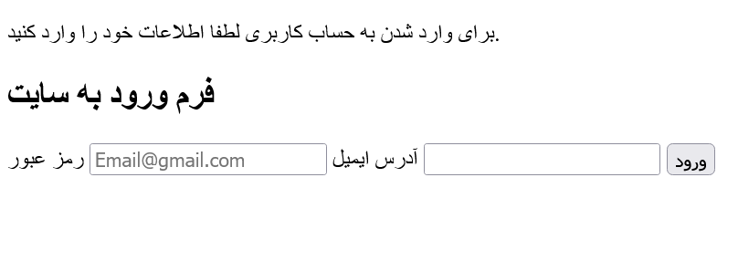
HTML document without applying CSS
html
output

Slide 6
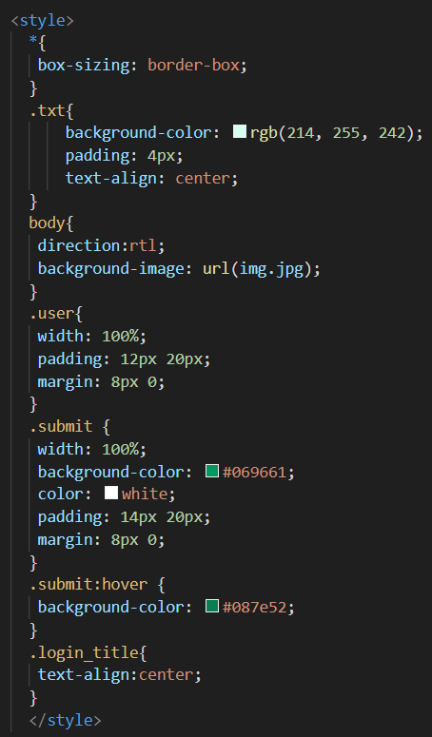
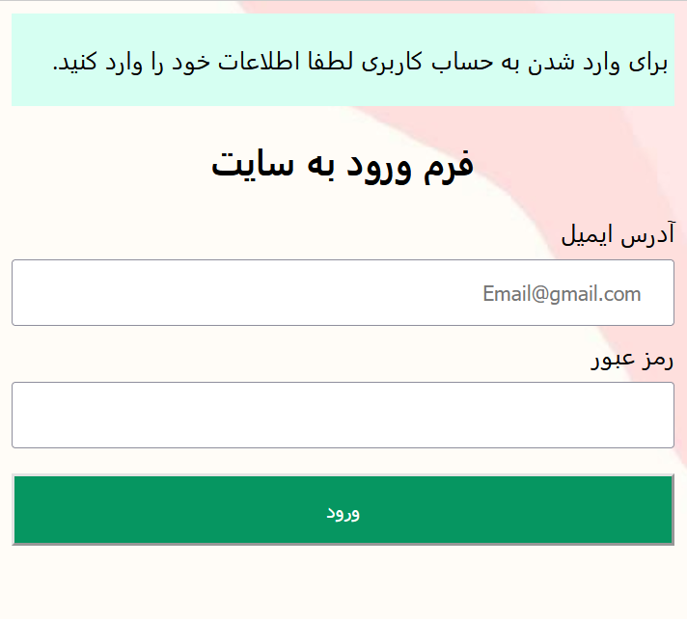
HTML document with applied CSS
html
css
output

Slide 7
CSS syntax
CSS syntax consists of a selector, a property, and a value.
General Structure:
selector {
property: value;
}
p {
color: red;
font-size: 16px;
}
Example:
This code sets the text color of the <p> tag to red and the font size to 16 pixels.

Slide 8
CSS Selectors
A CSS selector selects the HTML element(s) you want to style.
We can divide CSS selectors into five categories:
1
Simple selectors (select elements based on id, class, tags and etc.)
2
Combinator selectors (select elements based on a specific relationship between them)
3
Pseudo-class selectors (select elements based on a certain state)
4
Pseudo-elements selectors (select and style a part of an element)
5
Attribute selectors (select elements based on an attribute or attribute value)

Slide 9
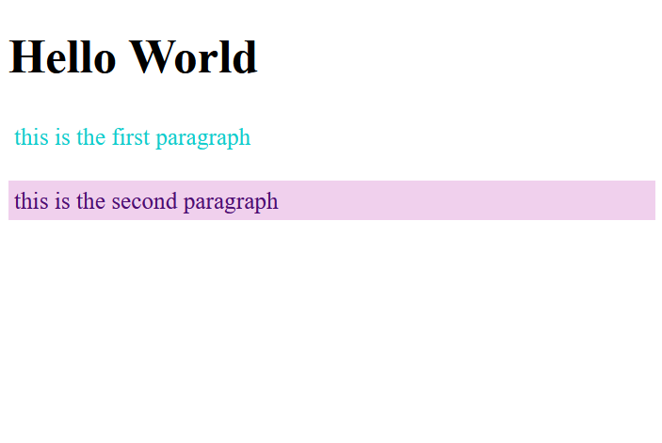
Simple selectors
.p1{
color: rgb(15, 205, 205);
padding: 4px;
}
#p2{
color: rgb(77, 14, 114);
padding: 4px;
background-color: rgb(240, 208, 237);
}
<h1>Hello World</h1>
<div>
<p class="p1">Hello World</p>
<p id="p2">Every paragraph will be affected by the style.</p>
html
css
output

Slide 10
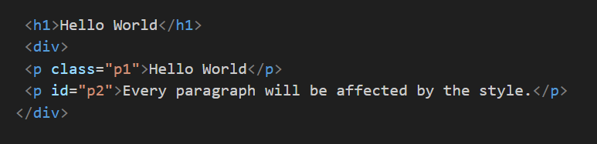
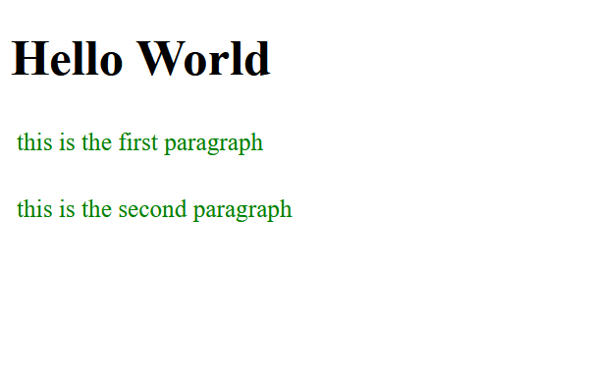
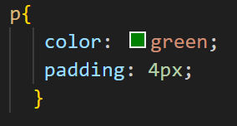
The CSS element Selector:
The element selector selects HTML elements based on the element name.
html
css
output

Slide 11
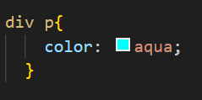
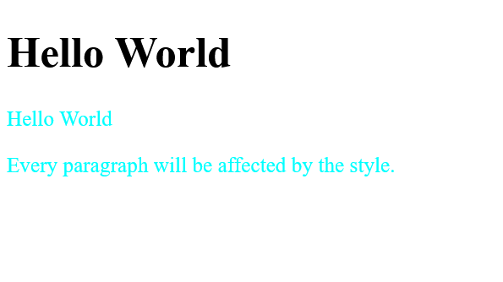
Example of Combinator selectors
html
css
ouyput

Slide 12

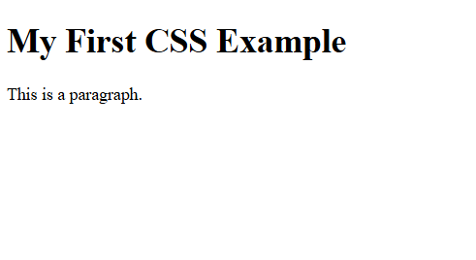
Consider this HTML code for the next slides:
<!DOCTYPE html>
<html>
<head>
</head>
<body>
<h1>My First CSS Example</h1>
<p>This is a paragraph.</p>
</body>
</html>

Slide 13
How To…
When a browser reads a style sheet, it will format the HTML document according to the information in the style sheet.
Inline CSS
1
Internal CSS
2
External CSS
3
05

Slide 14

1
Inline CSS
An inline style may be used to apply a unique style for a single element.
To use inline styles, add the style attribute to the relevant element. The style attribute can contain any CSS property.
Let’s see how…

Slide 15
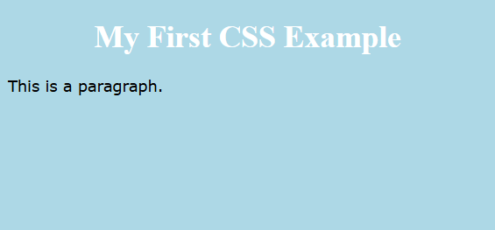
Example:
Inline styles are defined within the "style" attribute of the relevant element:
<!DOCTYPE html>
<html>
<head>
</head>
<body style='background-color: lightblue;'>
<h1 style='color: white; text-align: center;'>My First CSS Example</h1>
<p style='font-family: verdana;'>This is a paragraph.</p>
</body>
</html>

Slide 16
2
Internal CSS
An internal style sheet may be used if one single HTML page has a unique style.
The internal style is defined inside the <style> element, inside the head section.
Let’s see how…

Slide 17
Example:
Internal styles are defined within the <style> element, inside the <head> section of an HTML page:
<!DOCTYPE html>
<html>
<head>
<style>
body {
background-color: lightblue;
}
h1 {
color: white;
text-align: center;
}
p {
font-family: verdana;
}
</style>
</head>
<body>
<h1>My First CSS Example</h1>
<p>This is a paragraph.</p>
</body>
</html>

Slide 18
3
External CSS
With an external style sheet, you can change the look of an entire website by changing just one file!
Each HTML page must include a reference to the external style sheet file inside the <link> element, inside the head section.
Let’s see how…

Slide 19
Example:
External styles are defined within the <link> element, inside the <head> section of an HTML page :
<!DOCTYPE html> <html> <head> <link rel="stylesheet" href="mystyle.css"> </head> <body> <h1>My First CSS Example</h1>
<p>This is a paragraph.</p> </body> </html>
“mystyle.css”:
body {
background-color: lightblue;
}
h1 {
color: white;
text-align: center;
}
p {
font-family: verdana;
}

Slide 20

Which way is better?
There is no best way to add CSS to HTML elements. You should choose the best way to add the style you want, by yourself. For example, if you want to add a unique style to one element, inline styling is probably a better choice.

Slide 21
html and css
In CSS, some properties (attributes) apply to all HTML tags, while others only affect specific tags.
Properties that apply to all HTML tags:
13. cursor | 9. background-position | 5. box-shadow | 1. width
14. transition | 10. background-repeat | 6. background-color | 2. height
15. hover | 11. opacity | 7. background-image | 3. border
16. active | 12. padding / margin | 8. background-size | 4. border-radius

Slide 22
html and css
Properties that only apply to specific tags:
(These properties are limited to certain elements)
1. Only for replaced elements (img, video, iframe, object):
object-fit → Works on img, video, iframe, object, and picture.
background-size → Works on all elements but is mostly used for background styling.
background-position → Mostly used on div, body, section, and other elements with backgrounds.
2. Only for form controls (input, textarea, select, button, label):
focus (used within :focus) → Works on input, textarea, select, and button.

Slide 23
html and css
3. Only for buttons (button, input[type="submit"], input[type="button"]):
active (used within :active) → Mostly affects button, input[type="submit"], and input[type="button"].

Slide 24

CSS Text
1. Text Properties
Description | Property
Defines the text color | color
Specifies the font of the text. | font-family
Sets the size of the text | font-size
Defines the style (normal, italic, oblique). | font-style
Specifies the weight (boldness) of the text. | font-weight
Aligns text (left, right, center, justify) | text-align
Adds decoration (underline, overline, line-through) | text-decoration
Controls text capitalization (uppercase, lowercase, capitalize). | text-transform
Defines the spacing between lines | Text-spacing

Slide 25
2. Spacing and Shadow Properties
Description | Property
Defines spacing between letters. | letter-spacing
Specifies space between words | word-spacing
Controls the height of a text line. | line-height
Defines how white spaces are handled (normal, nowrap, pre). | white-space
Adds shadow effects to text. | text-shadow

Slide 26
3. Margin and Padding for Text
Description | Property
Defines the top margin | margin-top
Defines the right margin. | margin-right
Defines the bottom margin. | margin-bottom
Defines the left margin | margin-left
Defines the top padding | padding-top
Defines the right padding. | padding-right
Defines the bottom padding | padding-bottom
Defines the left padding. | padding-left

Slide 27
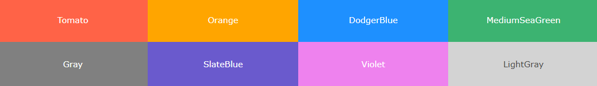
CSS Colors
Colors are specified using predefined color names, or RGB, HEX, HSL, RGBA, HSLA values.
In CSS, a color can be specified by using a predefined color name:

Slide 28
CSS RGB Colors
An RGB color value represents RED, GREEN, and BLUE light sources.
RGB Value
In CSS, a color can be specified as an RGB value, using this formula:
rgb(red, green, blue)
Each parameter (red, green, and blue) defines the intensity of the color between 0 and 255.
For example, rgb(255, 0, 0) is displayed as red, because red is set to its highest value (255) and the others are set to 0.
To display black, set all color parameters to 0, like this: rgb(0, 0, 0).
To display white, set all color parameters to 255, like this: rgb(255, 255, 255).

Slide 29
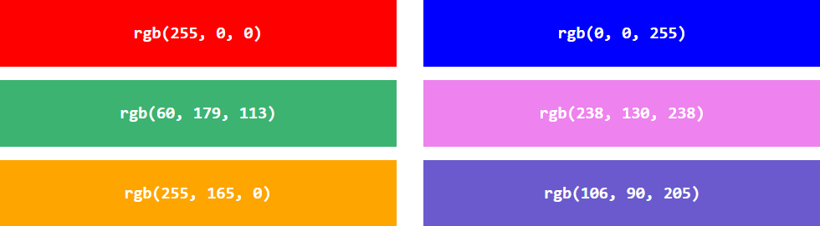
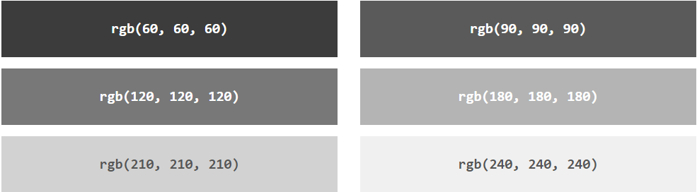
Example

Slide 30
RGBA Value
RGBA color values are an extension of RGB color values with an alpha channel - which specifies the opacity for a color.
An RGBA color value is specified with:
rgba(red, green, blue, alpha)
The alpha parameter is a number between 0.0 (fully transparent) and 1.0 (not transparent at all):

Slide 31
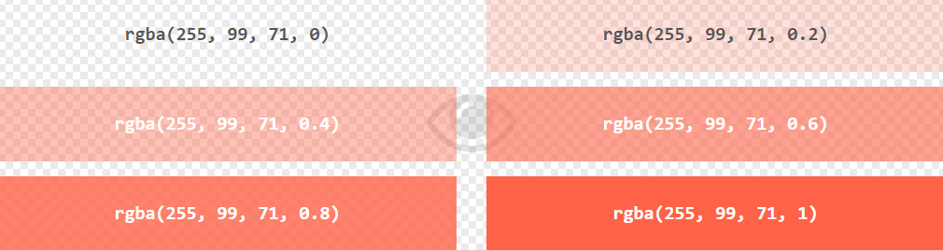
Example

Slide 32
HEX Value
In CSS, a color can be specified using a hexadecimal value in the form:
#rrggbb
Where rr (red), gg (green) and bb (blue) are hexadecimal values between 00 and ff (same as decimal 0-255).
For example, #ff0000 is displayed as red, because red is set to its highest value (ff) and the others are set to the lowest value (00).
To display black, set all values to 00, like this: #000000.
To display white, set all values to ff, like this: #ffffff.

Slide 33
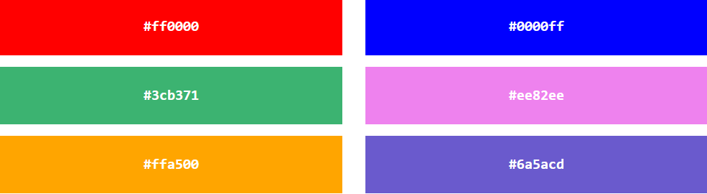
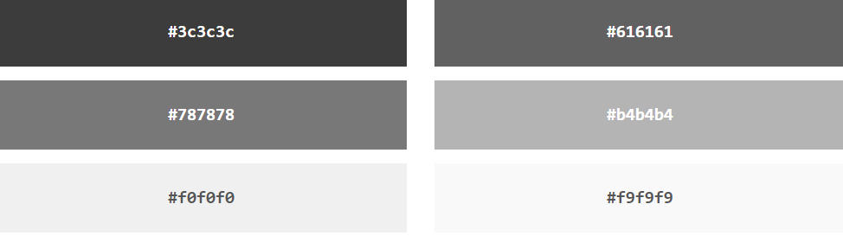
Example

Slide 34
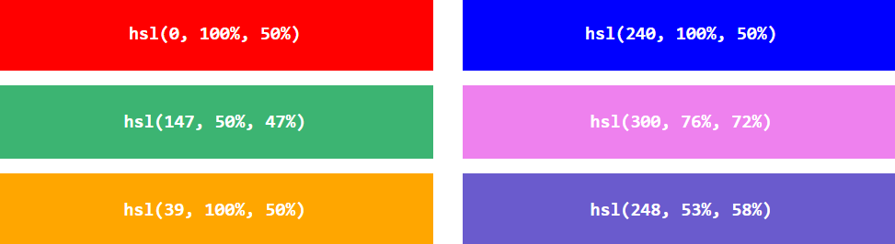
HSL Value
hsl(hue, saturation, lightness)
Example

Slide 35
CSS Margins
Margins are used to create space around elements, outside of any defined borders.
The CSS margin properties are used to create space around elements, outside of any defined borders.
CSS has properties for specifying the margin for each side of an element:
margin-top
margin-right
margin-bottom
margin-left

Slide 36
CSS Margins
To shorten the code, it is possible to specify all the margin properties in one property.
margin-top
margin-right
margin-bottom
margin-left
So, here is how it works:
If the margin property has four values:
margin: 25px 50px 75px 100px;
top margin is 25px
right margin is 50px
bottom margin is 75px
left margin is 100px

Slide 37
CSS Margins
If the margin property has one value:
margin: 25px;
all four margins are 25px
If the margin property has three values:
margin: 25px 50px 75px;
top margin is 25px
right and left margins are 50px
bottom margin is 75px
If the margin property has four values:
margin: 25px 50px 75px 100px;
top margin is 25px
right margin is 50px
bottom margin is 75px
left margin is 100px
If the margin property has two values:
margin: 25px 50px;
top and bottom margins are 25px
right and left margins are 50px

Slide 38
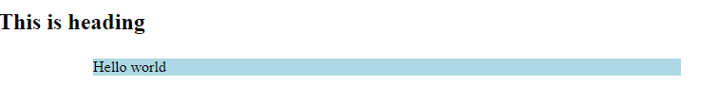
CSS Margins
Html & Internal css
Inline css
<!DOCTYPE html>
<html>
<head>
<style>
div {
margin: 25px 50px 75px 100px;
background-color: lightblue;
}
</style>
</head>
<body>
<h2>This is heading </h2>
<div>Hello world</div>
</body>
</html>
<div style="margin: 25px 50px 75px 100px; background-color: lightblue;">Hello world</div>
Output

Slide 39
CSS Padding
Padding is used to create space around an element's content, inside of any defined borders.
The CSS padding properties are used to generate space around an element's content, inside of any defined borders.
With CSS, you have full control over the padding. There are properties for setting the padding for each side of an element (top, right, bottom, and left).

Slide 40
CSS Padding
To shorten the code, it is possible to specify all the padding properties in one property.
The padding property is a shorthand property for the following individual padding properties:
padding-top
padding-right
padding-bottom
padding-left
So, here is how it works:
If the padding property has four values:
padding: 25px 50px 75px 100px;
top padding is 25px
right padding is 50px
bottom padding is 75px
left padding is 100px

Slide 41
CSS Padding
If the padding property has four values:
padding: 25px 50px 75px 100px;
top padding is 25px
right padding is 50px
bottom padding is 75px
left padding is 100px
If the padding property has two values:
padding: 25px 50px;
top and bottom paddings are 25px
right and left paddings are 50px
If the padding property has three values:
padding: 25px 50px 75px;
top padding is 25px
right and left paddings are 50px
bottom padding is 75px
If the padding property has one value:
padding: 25px;
all four paddings are 25px

Slide 42
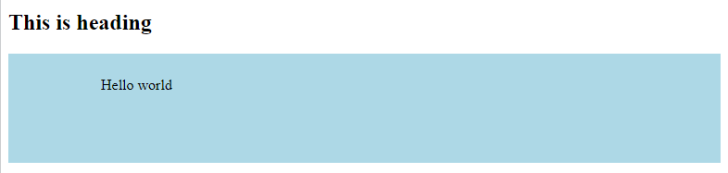
CSS Padding
Html & Internal css
Inline css
<!DOCTYPE html>
<html>
<head>
<style>
div {
padding: 25px 50px 75px 100px;
background-color: lightblue;
}
</style>
</head>
<body>
<h2>This is heading </h2>
<div>Hello world</div>
</body>
</html>
<div style=“padding: 25px 50px 75px 100px; background-color: lightblue;">Hello world</div>
Output

Slide 43
CSS Text
The color property is used to set the color of the text.
Inline css
<h1 style="color:green ; ">This is heading </h1>
<h2 style=" color: purple;">Hello world</h2>

Slide 44
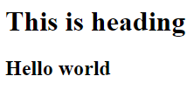
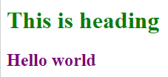
CSS Text
<!DOCTYPE html>
<html>
<head>
<style>
h2 {
color: purple;
}
h1 {
color: green;
}
</style>
</head>
<body>
<h1>This is heading </h1>
<h2>Hello world</h2>
</body>
</html>
Output html
Step 1
Html & Internal css
Output css
Step 2

Slide 45


CSS Text Alignment
The text-align property is used to set the horizontal alignment of a text.
Internal css
Internal css
<style>
h2 {
color: purple;
text-align: left;
}
h1 {
color: green;
text-align: center;
</style>
<style>
h2 {
color: purple;
text-align: left;
}
h1 {
color: green;
text-align:right;
</style>
Output css
Output css

Slide 46
CSS Text Decoration
The text-decoration-line property is used to add a decoration line to text.
Text Decoration
text-decoration-line
text-decoration-color
text-decoration-style
text-decoration-thickness
text-decoration

Slide 47
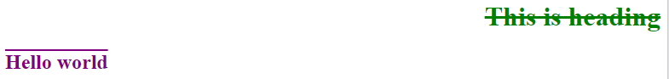
CSS Text Decoration
Internal css
Output css
<style>
h2 {
color: purple;
text-align: left;
text-decoration: overline;
}
h1 {
color: green;
text-align: right;
text-decoration: line-through;
</strle>

Slide 48
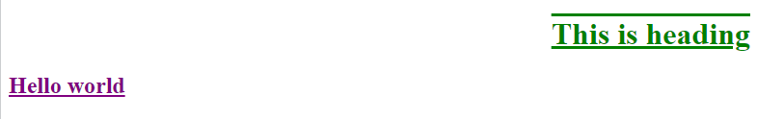
CSS Text Decoration
Internal css
Output css
<style>
h2 {
color: purple;
text-align: left;
text-decoration: underline;
}
h1 {
color: green;
text-align: right;
text-decoration: overline underline;
</style>

Slide 49
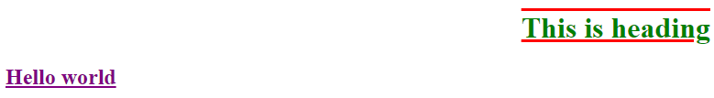
CSS Text Decoration
The text-decoration-color property is used to set the color of the decoration line.
Internal css
Output css
<style>
h2 {
color: purple;
text-align: left;
text-decoration: underline;
}
h1 {
color: green;
text-align: right;
text-decoration:overline underline;
text-decoration-color: red;
</style>
PPT下载 http://www.1ppt.com/xiazai/

Slide 50
CSS Text Decoration
The text-decoration-style property is used to set the style of the decoration line.
text-decoration-style: solid draw a single line
text-decoration-style: double draws a double line
text-decoration-style: dotted draws a dotted line
text-decoration-style: dashed draws a dashed line
text-decoration-style: wavy draws a wavy line

Slide 51
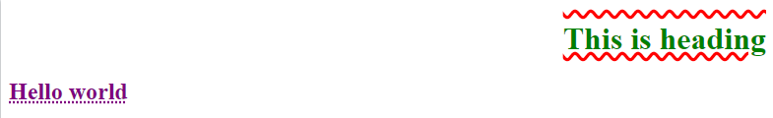
CSS Text Decoration
Internal css
Output css
<style>
h2 {
color: purple;
text-align: left;
text-decoration: underline;
text-decoration-style: dotted;
}
h1 {
color: green;
text-align: right;
text-decoration:overline underline;
text-decoration-color: red;
text-decoration-style: wavy;
</style>

Slide 52
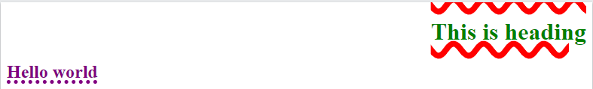
CSS Text Decoration
The text-decoration-thickness property is used to set the thickness of the decoration line.
Internal css
Output css
<style>
h2 {
color: purple;
text-align: left;
text-decoration: underline;
text-decoration-style: dotted;
text-decoration-thickness: 5px;
}
h1 {
color: green;
text-align: right;
text-decoration:overline underline;
text-decoration-color: red;
text-decoration-style: wavy;
text-decoration-thickness: 25%;
</style>

Slide 53
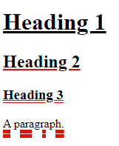
Example
html
Internal css
Output css
<!DOCTYPE html>
<html>
<head>
</head>
<body>
<h1>Heading 1</h1>
<h2>Heading 2</h2>
<h3>Heading 3</h3>
<p>A paragraph.</p>
</body>
</html>
<style>
h1 {
text-decoration: underline;
}
h2 {
text-decoration: underline red;
}
h3 {
text-decoration: underline red double;
}
p {
text-decoration: underline red double 5px;
}
</style>

Slide 54
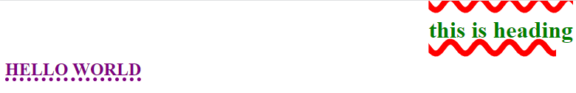
CSS Text Transformation
The text-transform property is used to specify uppercase and lowercase letters in a text.
Internal css
<style>
h2 {
color: purple;
text-align: left;
text-decoration: underline;
text-decoration-style: dotted;
text-decoration-thickness: 5px;
text-transform: uppercase;
}
h1 {
color: green;
text-align: right;
text-decoration:overline underline;
text-decoration-color: red;
text-decoration-style: wavy;
text-decoration-thickness: 25%;
text-transform: lowercase;
</style>
Output css

Slide 55
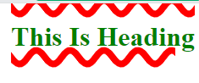
CSS Text Transformation
Internal css
Output css
<style>
h1 {
color: green;
text-align: right;
text-decoration: overline underline;
text-decoration-color: red;
text-decoration-style: wavy;
text-decoration-thickness: 25%;
text-transform: capitalize;
</style>

Slide 56
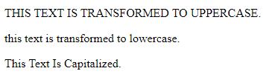
Example
Output
<!DOCTYPE html>
<html>
<head>
<style>
p.uppercase {
text-transform: uppercase;
}
p.lowercase {
text-transform: lowercase;
}
p.capitalize {
text-transform: capitalize;
}
</style>
</head>
<body>
<p class="uppercase">This text is transformed to uppercase.</p>
<p class="lowercase">This text is transformed to lowercase.</p>
<p class="capitalize">This text is capitalized.</p>
</body>
</html>

Slide 57
Text Spacing
CSS text spacing properties are used to specify the amount of space between characters, words, and lines of text in the block of content.
The various text spacing properties used in CSS are as follows:
text-indent
letter-spacing
line-height
word-spacing
white-space

Slide 58
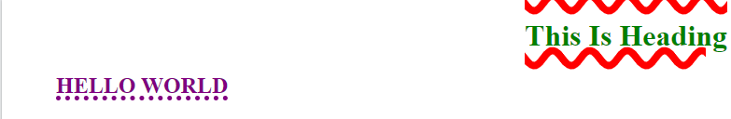
text-indent
Internal css
Output css
<style>
h2 {
color: purple;
text-align: left;
text-decoration: underline;
text-decoration-style: dotted;
text-decoration-thickness: 5px;
text-transform: uppercase;
text-indent: 50px;
}
h1 {
color: green;
text-align: right;
text-decoration:overline underline;
text-decoration-color: red;
text-decoration-style: wavy;
text-decoration-thickness: 25%;
text-transform: capitalize;
</style>

Slide 59
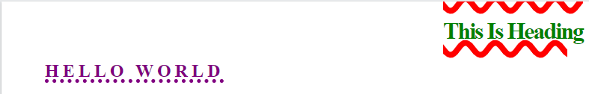
Letter Spacing
The letter-spacing property is used to specify the space between the characters in a text.
Internal css
Output css
<style>
h2 {
color: purple;
text-align: left;
text-decoration: underline;
text-decoration-style: dotted;
text-decoration-thickness: 5px;
text-transform: uppercase;
text-indent: 50px;
letter-spacing: 5px;
}
h1 {
color: green;
text-align: right;
text-decoration: overline underline;
text-decoration-color: red;
text-decoration-style: wavy;
text-decoration-thickness: 25%;
text-transform: capitalize;
letter-spacing: -2px;
</style>

Slide 60
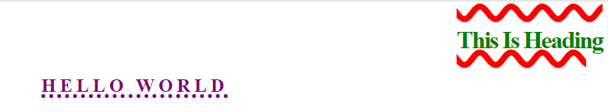
Line Height
The line-height property is used to specify the space between lines:
Internal css
Output css
<style>
h2 {
color: purple;
text-align: left;
text-decoration: underline;
text-decoration-style: dotted;
text-decoration-thickness: 5px;
text-transform: uppercase;
text-indent: 50px;
letter-spacing: 5px;
line-height: 0.7;
}
h1 {
color: green;
text-align: right;
text-decoration: overline underline;
text-decoration-color: red;
text-decoration-style: wavy;
text-decoration-thickness: 25%;
text-transform: capitalize;
letter-spacing: -2px;
line-height: 1.8;
</style>

Slide 61
Word Spacing
The word-spacing property is used to specify the space between the words in a text.
html
<!DOCTYPE html>
<html>
<head>
</head>
<body>
<h1 class=“one”>This is heading </h1>
<h2 class=“two”>Hello world</h2>
</body>
</html>

Slide 62
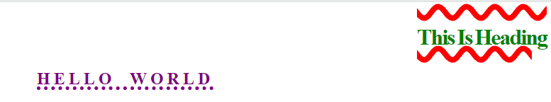
Internal css
Output css
<style>
.two {
color: purple;
text-align: left;
text-decoration: underline;
text-decoration-style: dotted;
text-decoration-thickness: 5px;
text-transform: uppercase;
text-indent: 50px;
letter-spacing: 5px;
line-height: 0.7;
word-spacing: 10px;
}
.one {
color: green;
text-align: right;
text-decoration:overline underline;
text-decoration-color: red;
text-decoration-style: wavy;
text-decoration-thickness: 25%;
text-transform: capitalize;
letter-spacing: -2px;
line-height: 1.8;
word-spacing: -2px;
</style>

Slide 63
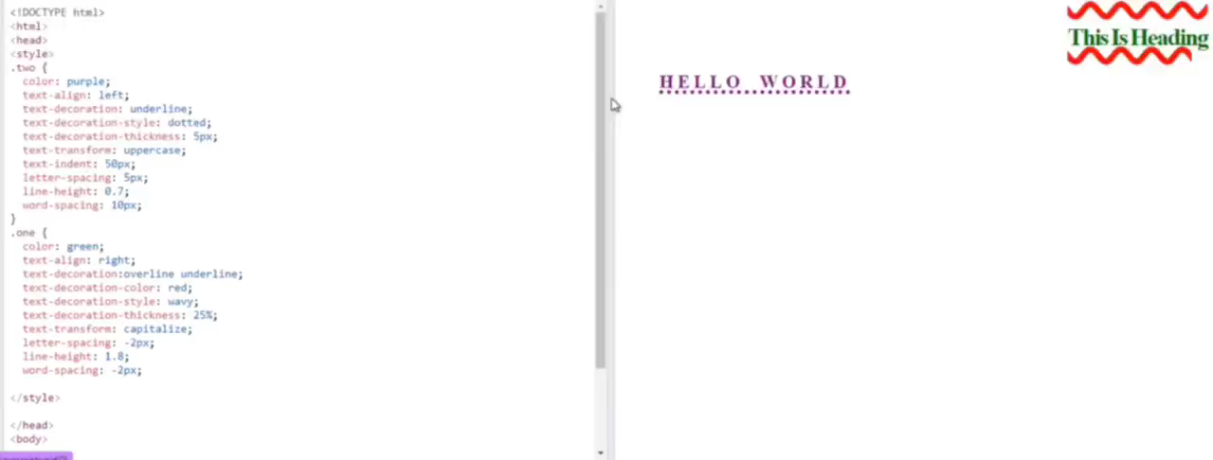
White Space
The white-space property specifies how white-space inside an element is handled.
Without using white space

Slide 64
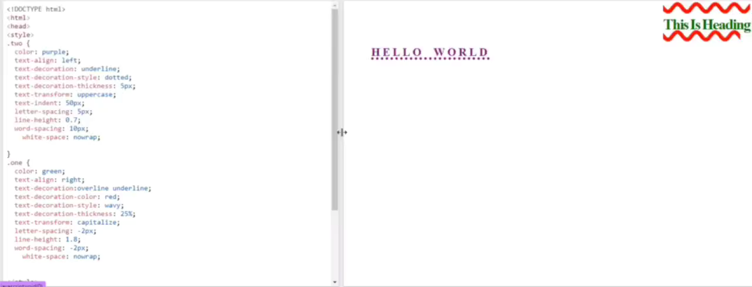
White Space
Using white space

Slide 65
CSS Text Shadow
The text-shadow property adds shadow to text.
Internal css
<style>
.two {
color: purple;
text-align: left;
text-decoration: underline;
text-decoration-style: dotted;
text-decoration-thickness: 5px;
text-transform: uppercase;
text-indent: 50px;
letter-spacing: 5px;
line-height: 0.7;
word-spacing: 10px;
white-space: nowrap;
text-shadow: 2px 2px 5px red;
}
.one {
color: green;
text-align: right;
text-decoration:overline underline;
text-decoration-color: red;
text-decoration-style: wavy;
text-decoration-thickness: 25%;
text-transform: capitalize;
letter-spacing: -2px;
line-height: 1.8;
word-spacing: -2px;
white-space: nowrap;
text-shadow: 2px 2px;
</style>

Slide 66
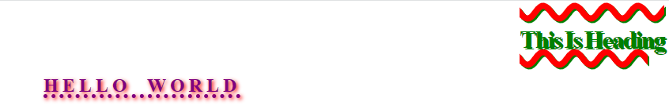
CSS Text Shadow
Output css

Slide 67
CSS Fonts
In CSS, we use the font-family property to specify the font of a text.
Generic Font Families
In CSS there are five generic font families:
Serif fonts have a small stroke at the edges of each letter. They create a sense of formality and elegance.
Sans-serif fonts have clean lines (no small strokes attached). They create a modern and minimalistic look.
Monospace fonts - here all the letters have the same fixed width. They create a mechanical look.
Cursive fonts imitate human handwriting.
Fantasy fonts are decorative/playful fonts.

Slide 68
CSS Fonts
Internal css
<style>
.two {
color: purple;
text-align: left;
text-decoration: underline;
text-decoration-style: dotted;
text-decoration-thickness: 5px;
text-transform: uppercase;
text-indent: 50px;
letter-spacing: 5px;
line-height: 0.7;
word-spacing: 10px;
white-space: nowrap;
text-shadow: 2px 2px 5px red;
font-family: Arial, Helvetica, sans-serif;
}
.one {
color: green;
text-align: right;
text-decoration:overline underline;
text-decoration-color: red;
text-decoration-style: wavy;
text-decoration-thickness: 25%;
text-transform: capitalize;
letter-spacing: -2px;
line-height: 1.8;
word-spacing: -2px;
white-space: nowrap;
text-shadow: 2px 2px;
</style>

Slide 69

CSS Fonts
Output css

Slide 70
CSS Font Style
The font-style property is mostly used to specify italic text.
This property has three values:
normal - The text is shown normally
italic - The text is shown in italics
oblique - The text is "leaning" (oblique is very similar to italic, but less supported)

Slide 71
CSS Font Style
Internal css
<style>
.two {
color: purple;
text-align: left;
text-decoration: underline;
text-decoration-style: dotted;
text-decoration-thickness: 5px;
text-transform: uppercase;
text-indent: 50px;
letter-spacing: 5px;
line-height: 0.7;
word-spacing: 10px;
white-space: nowrap;
text-shadow: 2px 2px 5px red;
font-family: Arial, Helvetica, sans-serif;
font-style: italic;
}
.one {
color: green;
text-align: right;
text-decoration:overline underline;
text-decoration-color: red;
text-decoration-style: wavy;
text-decoration-thickness: 25%;
text-transform: capitalize;
letter-spacing: -2px;
line-height: 1.8;
word-spacing: -2px;
white-space: nowrap;
text-shadow: 2px 2px;
font-style: oblique;
</style>

Slide 72

CSS Font Style
Output css

Slide 73
Font Weight
The font-weight property specifies the weight of a font:
Internal css
<style>
.two {
color: purple;
text-align: left;
text-decoration: underline;
text-decoration-style: dotted;
text-decoration-thickness: 5px;
text-transform: uppercase;
text-indent: 50px;
letter-spacing: 5px;
line-height: 0.7;
word-spacing: 10px;
white-space: nowrap;
text-shadow: 2px 2px 5px red;
font-family: Arial, Helvetica, sans-serif;
font-style: italic;
}
.one {
color: green;
text-align: right;
text-decoration:overline underline;
text-decoration-color: red;
text-decoration-style: wavy;
text-decoration-thickness: 25%;
text-transform: capitalize;
letter-spacing: -2px;
line-height: 1.8;
word-spacing: -2px;
white-space: nowrap;
text-shadow: 2px 2px;
font-style: oblique;
font-weight: bold
</style>

Slide 74

Font Weight
Output css

Slide 75

CSS Font Size
The font-size property sets the size of the text.
Internal css
Set Font Size With Pixels
.two {
color: purple;
text-align: left;
text-decoration: underline;
text-decoration-style: dotted;
text-decoration-thickness: 5px;
text-transform: uppercase;
text-indent: 50px;
letter-spacing: 5px;
line-height: 0.7;
word-spacing: 10px;
white-space: nowrap;
text-shadow: 2px 2px 5px red;
font-family: Arial, Helvetica, sans-serif;
font-style: italic;
font-size: 40px;
}
Setting the text size with pixels gives you full control over the text size:
Output css

Slide 76
CSS Font Size
Set Font Size With Em
To allow users to resize the text (in the browser menu), many developers use em instead of pixels.
1em is equal to the current font size. The default text size in browsers is 16px. So, the default size of 1em is 16px.
The size can be calculated from pixels to em using this formula: pixels/16=em

Slide 77
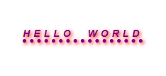
CSS Font Size
Set Font Size With Em
Internal css
.two {
color: purple;
text-align: left;
text-decoration: underline;
text-decoration-style: dotted;
text-decoration-thickness: 5px;
text-transform: uppercase;
text-indent: 50px;
letter-spacing: 5px;
line-height: 0.7;
word-spacing: 10px;
white-space: nowrap;
text-shadow: 2px 2px 5px red;
font-family: Arial, Helvetica, sans-serif;
font-style: italic;
font-size: 0.875em
}
Output css

Slide 78
CSS @font-face
Definition and Usage
With the CSS @font-face rule, web designers do not have to use one of the "web-safe" fonts anymore.
In the @font-face rule you must first define a name for the font (e.g. myFirstFont), and then point to the font file.
To use the font for an HTML element, refer to the name of the font (myFirstFont) through the font-family property:
div { font-family: myFirstFont; }

Slide 79
CSS @font-face
With the CSS @font-face rule, web designers do not have to use one of the "web-safe" fonts anymore.
In the @font-face rule you must first define a name for the font (e.g. myFirstFont), and then point to the font file
Browser Support
The @font-face rule is supported in Edge, Chrome, Firefox, Safari, and Opera.
Syntax
@font-face { font-properties }

Slide 80
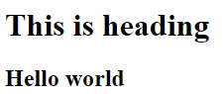
<!DOCTYPE html>
<html>
<head>
<style>
@font-face {
font-family: myFirstFont;
src: url(sansation_light.woff);
}
@font-face {
font-family: myFirstFont;
src: url(sansation_bold.woff);
font-weight: bold;
}
div {
font-family: myFirstFont;
}
</style>
</head>
<body>
<h1 class=“one”>This is heading </h1>
<h2 class=“two”>Hello world</h2>
</body>
</html>
html & Internal css
Output css

Slide 81
CSS Layout - display: inline-block
Compared to display: inline, the major difference is that display: inline-block allows to set a width and height on the element.
Also, with display: inline-block, the top and bottom margins/paddings are respected, but with display: inline they are not.
Compared to display: block, the major difference is that display: inline-block does not add a line-break after the element, so the element can sit next to other elements.

Slide 82
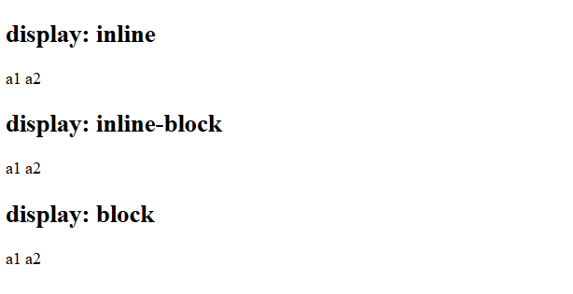
Example:
The following example shows the different behavior of display: inline, display: inline-block and display: block:
<!DOCTYPE html>
<html>
<body>
<h2>display: inline</h2>
<div><span class="a">a1</span> <span class="a">a2</span> </div>
<h2>display: inline-block</h2>
<div> <span class="b">a1</span> <span class="b">a2</span> </div>
<h2>display: block</h2>
<div> <span class="c">a1</span> <span class="c">a2</span> </div>
</body>
</html>

Slide 83
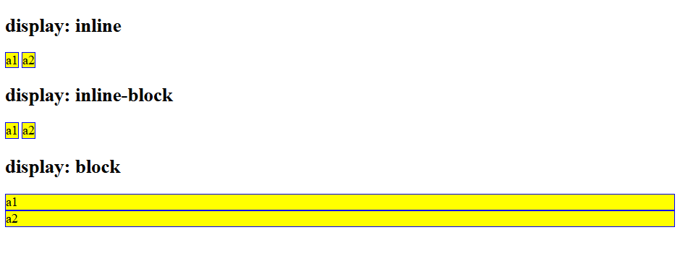
Example:
The following example shows the different behavior of display: inline, display: inline-block and display: block:
<style>
span.a {
display: inline; /* the default for span */
border: 1px solid blue;
background-color: yellow;
}
span.b {
display: inline-block;
border: 1px solid blue;
background-color: yellow;
}
span.c {
display: block;
border: 1px solid blue;
background-color: yellow;
}
</style>

Slide 84

Using inline-block to Create Navigation Links
One common use for display: inline-block is to display list items horizontally instead of vertically. The following example creates horizontal navigation links.
Let’s see how…

Slide 85
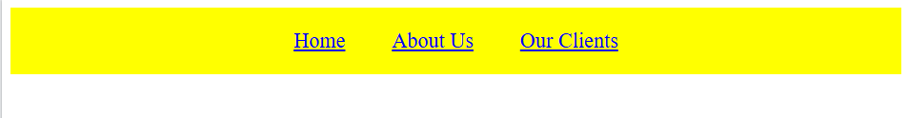
<html>
<head>
<style>
.nav {
background-color: yellow;
list-style-type: none;
text-align: center;
margin: 0;
padding: 0;
}
.nav li {
display: inline-block;
font-size: 20px;
padding: 20px;
}
</style>
</head>
<body>
<ul class="nav">
<li><a href="#home">Home</a></li>
<li><a href="#about">About Us</a></li>
<li><a href="#clients">Our Clients</a></li>
</ul>
</body>
</html>

Slide 86
CSS Layout - The position Property
The position property specifies the type of positioning method used for an element.There are five different position values:
Elements are then positioned using the top, bottom, left, and right properties. However, these properties will not work unless the position property is set first. They also work differently depending on the position value.
static
relative
fixed
absolute
sticky

Slide 87
CSS Layout - The position Property
position: static;
HTML elements are positioned static by default.
Static positioned elements are not affected by the top, bottom, left, and right properties.
An element with position: static; is not positioned in any special way; it is always positioned according to the normal flow of the page:
div {
position: static;
border: 3px solid #73AD21;
}

Slide 88
CSS Layout - The position Property
position: relative;
An element with position: relative; is positioned relative to its normal position.
Setting the top, right, bottom, and left properties of a relatively-positioned element will cause it to be adjusted away from its normal position. Other content will not be adjusted to fit into any gap left by the element.
Let’s see how…

Slide 89
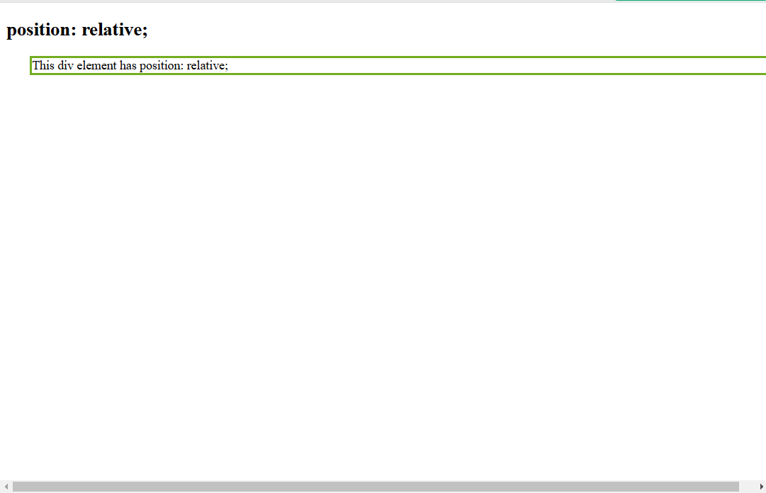
position: relative;
Example:
<!DOCTYPE html>
<html>
<head>
<style>
div.relative {
position: relative;
left: 30px;
border: 3px solid #73AD21;
}
</style>
</head>
<body>
<h2>position: relative;</h2>
<div class="relative">
This div element has position: relative;
</div>
</body>
</html>

Slide 90
CSS Layout - The position Property
position: fixed;
An element with position: fixed; is positioned relative to the viewport, which means it always stays in the same place even if the page is scrolled. The top, right, bottom, and left properties are used to position the element.
A fixed element does not leave a gap in the page where it would normally have been located.
Let’s see how…

Slide 91
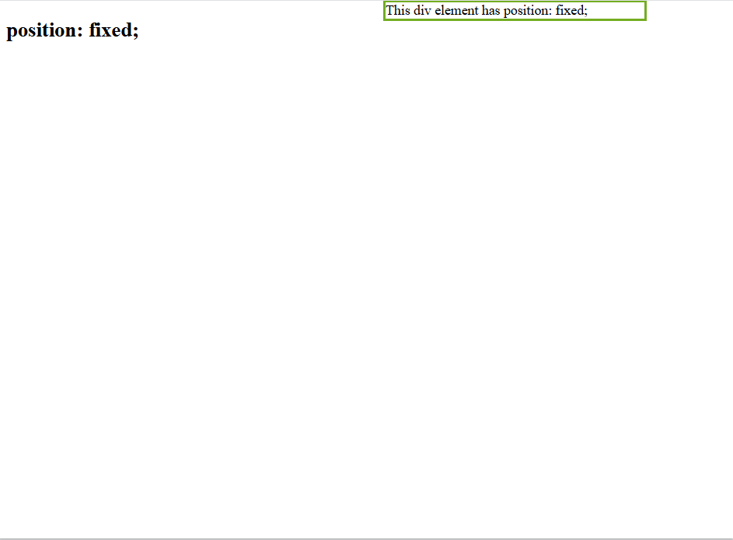
position: fixed;
Example:
<!DOCTYPE html>
<html>
<head>
<style>
div.fixed {
position: fixed;
bottom: 600px;
right: 100px;
width: 300px;
border: 3px solid #73AD21;
}
</style>
</head>
<body>
<h2>position: fixed;</h2>
<div class="fixed">
This div element has position: fixed;
</div>
</body>
</html>

Slide 92
CSS Layout - The position Property
position: absolute;
An element with position: absolute; is positioned relative to the nearest positioned ancestor (instead of positioned relative to the viewport, like fixed).
However; if an absolute positioned element has no positioned ancestors, it uses the document body, and moves along with page scrolling.
Absolute positioned elements are removed from the normal flow, and can overlap elements.
Let’s see how…

Slide 93

position: absolute;
Example:
<body>
<h2>position: absolute;</h2>
<div class="relative"> This div element has position: relative;
<div class="absolute">This div element has position: absolute;</div>
</div>
</body>
</html>
<!DOCTYPE html>
<html>
<head>
<style>
div.relative {
position: relative;
width: 400px;
height: 200px;
border: 3px solid #73AD21;
}
div.relative {
position: absolute;
top: 80px;
right: 0;
width: 200px;
height: 100px;
border: 3px solid #73AD21;
}
</style>
</head>

Slide 94
CSS Layout - The position Property
position: sticky;
An element with position: sticky; is positioned based on the user's scroll position.
A sticky element toggles between relative and fixed, depending on the scroll position. It is positioned relative until a given offset position is met in the viewport - then it "sticks" in place (like position:fixed).
You must specify at least one of top, right, bottom or left for sticky positioning to work.
Let’s see how…

Slide 95

position: sticky;
Example:
<!DOCTYPE html>
<html>
<head>
<style>
div.sticky {
position: sticky;
top: 0;
padding: 5px;
background-color: #cae8ca;
border: 2px solid #4CAF50;
}
</style>
</head>
<body>
<p>Try to <b>scroll</b> inside this frame to understand how sticky positioning works.</p>
<div class="sticky">I am sticky!</div>
<div style="padding-bottom:2000px">
<p>In this example, the sticky element sticks to the top of the page (top: 0), when you reach its scroll position.</p>
</div>
</body>
</html>

Slide 96
CSS Layout - Overflow
The overflow property specifies whether to clip the content or to add scrollbars when the content of an element is too big to fit in the specified area. The overflow property only works for block elements with a specified height.
The overflow property has the following values:
visible - Default. The overflow is not clipped. The content renders outside the element's box
hidden - The overflow is clipped, and the rest of the content will be invisible
scroll - The overflow is clipped, and a scrollbar is added to see the rest of the content
auto - Similar to scroll, but it adds scrollbars only when necessary
Let’s see how…

Slide 97

overflow: visible
By default, the overflow is visible, meaning that it is not clipped and it renders outside the element's box:
<!DOCTYPE html>
<html>
<head>
<style>
div {
background-color: coral;
width: 200px;
height: 65px;
border: 1px solid;
overflow: visible;
}
</style>
</head>
<body>
<h2>Overflow: visible</h2>
<div>You can use the overflow property when you want to have better control of the layout. The overflow property specifies what happens if content overflows an element's box.</div>
</body>
</html>

Slide 98

overflow: hidden
With the hidden value, the overflow is clipped, and the rest of the content is hidden:
<!DOCTYPE html>
<html>
<head>
<style>
div {
background-color: coral;
width: 200px;
height: 65px;
border: 1px solid black;
overflow: hidden;
}
</style>
</head>
<body>
<h2>Overflow: hidden</h2>
<div>You can use the overflow property when you want to have better control of the layout. The overflow property specifies what happens if content overflows an element's box.</div>
</body>
</html>

Slide 99

overflow: scroll
Setting the value to scroll, the overflow is clipped and a scrollbar is added to scroll inside the box. Note that this will add a scrollbar both horizontally and vertically (even if you do not need it):
<!DOCTYPE html>
<html>
<head>
<style>
div {
background-color: coral;
width: 200px;
height: 100px;
border: 1px solid black;
overflow: scroll;
}
</style>
</head>
<body>
<h2>Overflow: scroll</h2>
<div>You can use the overflow property when you want to have better control of the layout. The overflow property specifies what happens if content overflows an element's box.</div>
</body>
</html>

Slide 100

overflow: auto
The auto value is similar to scroll, but it adds scrollbars only when necessary:
<!DOCTYPE html>
<html>
<head>
<style>
div {
background-color: coral;
width: 200px;
height: 65px;
border: 1px solid black;
overflow: auto;
}
</style>
</head>
<body>
<h2>Overflow: auto</h2>
<div>You can use the overflow property when you want to have better control of the layout. The overflow property specifies what happens if content overflows an element's box.</div>
</body>
</html>

Slide 101


image
html
output
out put
output
5

Slide 102
CSS Width
The width CSS property sets an element's width. By default, it sets the width of the content area.
The specified value of width applies to the content area so long as its value remains within the values defined by min-width and max-width.
If the value for width is less than the value for min-width, then min-width overrides width.
If the value for width is greater than the value for max-width, then max-width overrides width.

Slide 103

CSS height
1
The height CSS property specifies the height of an element. By default, the property defines the height of the content area.
2
The min-height and max-height properties override height.
The height and width properties do not include padding, borders, or margins. It sets the height/width of the area inside the padding, border, and margin of the element.

Slide 104

Example of CSS Width, CSS height
html
output
css
output
output

Slide 105
CSS object-fit
The CSS object-fit property is used to specify how an <img> or <video> should be resized to fit its container.
This property tells the content to fill the container in a variety of ways; such as "preserve that aspect ratio" or "stretch up and take up as much space as possible".

Slide 106
CSS object-fit
The object-fit property can take one of the following values:
Fill: This is default. The image is resized to fill the given dimension. If necessary, the image will be stretched or squished to fit
Contain: The image keeps its aspect ratio, but is resized to fit within the given dimension.
Cover: the image keeps its aspect ratio and fills the given dimension. The image will be clipped to fit
None: The image is not resized
Scale-down: The image is scaled down to the smallest version of none or contain

Slide 107

CSS object-fit
Look at the following image from paris. This image is 400 pixels wide and 300 pixels high:

Slide 108

CSS object-fit
However, if we style the image above to be half its width (200 pixels) and same height (300 pixels), it will look like this:

Slide 109


Example of CSS object-fit
html
output
css

Slide 110

Example of CSS object-fit
<h1>Hello World</h1>
<div class="p1-class">
<p class="p1">this is the first paragraph</p>
</div>
<div class="p2-class">
<p class="p2">this is the second paragraph</p>
</div>
<div class="div-img">
<img src="img1.jpg" class="img" alt="">
</div>
html
output
.img{
width: 200px;
height: 300px;
object-fit: contain;
}
css

Slide 111

Example of CSS object-fit
<h1>Hello World</h1>
<div class="p1-class">
<p class="p1">this is the first paragraph</p>
</div>
<div class="p2-class">
<p class="p2">this is the second paragraph</p>
</div>
<div class="div-img">
<img src="img1.jpg" class="img" alt="">
</div>
html
.img{
width: 200px;
height: 300px;
object-fit: fill;
}
output
css

Slide 112
CSS Borders
Borders in CSS are used to create a visible outline around an element. They can be customized in terms of :
1
2
3
The appearance of the border (solid, dashed, dotted, etc…).
The color of the border.
The thickness of the border.
Width
Style
Color

Slide 113

CSS Borders
The border-width shorthand CSS property sets the width of an element's border.
border-width
border-width: medium|thin|thick|length|initial|inherit;
border-width
The border-style property specifies what kind of border to display.
border-style: none|hidden|dotted|dashed|solid|double|groove|ridge|inset|outset|initial|inherit;
The border-color property sets the color of an element's four borders. This property can have from one to four values.
border-color: color|transparent|initial|inherit;
Note: Always declare the border-style property before the border-width property and border-color property. An element must have borders before you can set the width and change the color.

Slide 114



Example of CSS Borders
html
css
output

Slide 115


Example of border-width, border-style, border-color
html
output
css

Slide 116


Example of CSS Borders (top, bottom, right, left)
html
output
css

Slide 117


CSS Borders
The border-style property can have from one to four values (for the top border, right border, bottom border, and the left border)
border-top
border-bottom
border-right
border-left

Slide 118

CSS border-block
The border-block property is a shorthand property for these properties:
1
2
3
border-block-width
border-block-style (required(
border-block-color
The CSS border-block property is very similar to CSS property border, but the border-block property is dependent on block direction.

Slide 119

Example of border-block
<h1>Hello World</h1>
<div class="p1-class">
<p class="p1">this is the first paragraph</p>
</div>
<div class="p2-class">
<p class="p2">this is the second paragraph</p>
</div>
<div class="div-img">
<img src="img1.jpg" class="img" alt="">
</div>
html
output
.img{
width: 200px;
height: 300px;
object-fit: cover;
border-block: 8px dashed rgb(249, 68, 234);
}
css

Slide 120
CSS border-radius
The border-radius CSS property rounds the corners of an element's outer border edge. You can set a single radius to make circular corners, or two radii to make elliptical corners.

Slide 121

Example of border-radius
<h1>Hello World</h1>
<div class="p1-class">
<p class="p1">this is the first paragraph</p>
</div>
<div class="p2-class">
<p class="p2">this is the second paragraph</p>
</div>
<div class="div-img">
<img src="img1.jpg" class="img" alt="">
</div>
html
output
.img{
width: 200px;
height: 300px;
object-fit: cover;
border-color: rgb(250,0,255);
border-radius: 15px;
}
css

Slide 122

Example of border-radius
<h1>Hello World</h1>
<div class="p1-class">
<p class="p1">this is the first paragraph</p>
</div>
<div class="p2-class">
<p class="p2">this is the second paragraph</p>
</div>
<div class="div-img">
<img src="img1.jpg" class="img" alt="">
</div>
html
output
.img{
width: 200px;
height: 300px;
object-fit: cover;
border-color: rgb(250,0,255);
border-radius: 10% 15% 50% 30%;
}
css

Slide 123
CSS box-shadow
The box-shadow CSS property adds shadow effects around an element's frame.
The spread parameter defines the spread radius. A positive value increases the size of the shadow, a negative value decreases the size of the shadow.

Slide 124





Example of CSS box-shadow
html
css
output

Slide 125


Example of CSS box-shadow
html
output
css

Slide 126


Example of CSS box-shadow
html
output
css

Slide 127

CSS Backgrounds
The CSS background properties are used to add background effects for elements.
1
CSS background-color
The background-color property specifies the background color of an element.
2
CSS background-image
The background-image property specifies an image to use as the background of an element.
By default, the image is repeated so it covers the entire element.

Slide 128


Example of CSS background-color
html
css
output

Slide 129



Example of background-image
html
output
css

Slide 130
CSS Background Image Repeat
By default, the background-image property repeats an image both horizontally and vertically.
Some images should be repeated only horizontally or vertically, or they will look strange
Tip: To repeat an image vertically, set background-repeat: repeat-y;

Slide 131


Example of background-image Repeat
html
output
css

Slide 132


Example of background-image Repeat
html
output
css

Slide 133

CSS background-position
The background-position property is used to specify the position of the background image.

Slide 134



Example of background-position
html
output
css

Slide 135
css background size
The CSS background-size property allows you to specify the size of background images.
The size can be specified in lengths, percentages, or by using one of the two keywords:
1
contain
2
cover

Slide 136


Example of CSS background Size
html
output
css

Slide 137
CSS opacity / transparency
The opacity property specifies the opacity/transparency of an element.
The opacity property can take a value from 0.0 - 1.0. The lower the value, the more transparent

Slide 138



Example of CSS opacity / transparency
html
output
css

Slide 139
CSS Buttons
The <button> HTML element is an interactive element activated by a user with a mouse, keyboard, finger, voice command, or other assistive technology.
Once activated, it then performs an action, such as submitting a form or opening a dialog
you can change buttons' appearance with CSS
html
8

Slide 140





CSS button
Web developer@upgradelt:~
<body>
<button class=“button button1">Button</button>
<input type="button" class=“ button button2" value="Input Button">
</body>
output
html

Slide 141


CSS background-color
html
<body>
<button class=“button button1">Button</button>
<input type="button" class=“ button button2" value="Input Button">
</body>
css
<style>
. button1 {
background-color: rgb(190, 182, 255);
color: rgb(0, 0, 0);
}
. button2{
background-color: rgb(178, 219, 255);
}
</style>
output

Slide 142




CSS border
html
css
output

Slide 143


CSS border-radius
html
output
css

Slide 144


CSS margin
html
css
output

Slide 145


CSS padding
html
css
output

Slide 146


CSS Box-shadow
html
css
output

Slide 147
cursor
Specifies the type of cursor to be displayed when hovering over an element.
CSS Syntax:
cursor: value;
Property Values:
1. pointer
2. Text
3. not-allowed
4. Move
5. all-scroll

Slide 148


Example of cursor
html
output
css

Slide 149


hover
html
output
css

Slide 150
active
The CSS active pseudo-class is used to select and style an element that is being activated by the user.
The active pseudo-class is most used on <a> and <button> elements. A link becomes activated when the user clicks on it, the same goes for a button.

Slide 151


Example of active
html
output
css

Slide 152
CSS transitions
CSS transitions allows you to change property values smoothly, over a given duration.
Specifies the change in property values over time
To create a transition effect, you must specify two things:
The CSS property you want to add an effect to the duration of the effect

Slide 153

Example of CSS transitions
<body>
<button class=“button button1">Button</button>
<input type="button" class=“ button button2" value="Input Button">
</body>
html
<style>
div {
width: 100px;
height: 100px;
background: red;
transition: width 2s;
}
div:hover {
width: 300px;
}
</style>
output
css

Slide 154


form
html
output
9

Slide 155

Example of form(width,height)
html
output
css

Slide 156


Example of form(padding,margin)
html
css
output

Slide 157


Example of form(Color/background-color(
html
css
output

Slide 158


Example of form(border/border-radius(
html
output
css

Slide 159
CSS box-sizing
The CSS box-sizing property allows us to include the padding and border in an element's total width and height.
By default, the width and height of an element is calculated like this:
width + padding + border = actual width of an element
height + padding + border = actual height of an element
This means: When you set the width/height of an element, the element often appears bigger than you have set (because the element's border and padding are added to the element's specified width/height).
The box-sizing property solves this problem.
The box-sizing property allows us to include the padding and border in an element's total width and height.
If you set box-sizing: border-box; on an element, padding and border are included in the width and height

Slide 160


Example of CSS box-sizing
html
css
output

Slide 161
Focused Inputs
By default, some browsers will add a blue outline around the input when it gets focus (clicked on). You can remove this behavior by adding outline: none; to the input.
You can remove this behavior by adding outline: none; to the input.
Use the :focus selector to do something with the input field when it gets focus

Slide 162


Example of Focused Inputs
css
output
html

Slide 163


hover
html
output
css

Slide 164

CSS Lists
In HTML, there are two main types of lists:
unordered lists (<ul>) - the list items are marked with bullets
ordered lists (<ol>) - the list items are marked with numbers or letters

Slide 165

CSS Lists
<!DOCTYPE html>
<html>
<body>
<p>Example of ordered lists:</p>
<ol class="c">
<li>Coffee</li>
<li>Tea</li>
<li>Coca Cola</li>
</ol>
<ol class="d">
<li>Coffee</li>
<li>Tea</li>
<li>Coca Cola</li>
</ol>
</body>
</html>
html
output
<p>Example of unordered lists:</p>
<ul class="a">
<li>Coffee</li>
<li>Tea</li>
<li>Coca Cola</li>
</ul>
<ul class="b">
<li>Coffee</li>
<li>Tea</li>
<li>Coca Cola</li>
</ul>
This is pure HTML.
Let’s add CSS and see what we can do with lists.

Slide 166

CSS Lists
The list-style-type property specifies the type of list item marker.
The CSS list properties allow you to:
Set different list item markers for ordered lists
Set different list item markers for unordered lists
Set an image as the list item marker
Add background colors to lists and list items

Slide 167
Different List Item Markers
The list-style-type property specifies the type of list item marker.
The following example shows some of the available list item markers:
ul:
circleSet
Square
ol:
upper-roman
lower-alpha

Slide 168

Different List Item Markers
<head>
<style>
ul.a {
list-style-type: circle;
}
ul.b {
list-style-type: square;
}
ol.c {
list-style-type: upper-roman;
}
ol.d {
list-style-type: lower-alpha;
}
</style>
</head>

Slide 169

An Image as The List Item Marker
The list-style-image property specifies an image as the list item marker:
<head>
<style>
ul.a {
list-style-image: url('sqpurple.gif')
}
ul.b {
list-style-image: url('sqpurple.gif')
}
</style>
</head>

Slide 170


Position The List Item Markers
The list-style-position property specifies the position of the list-item markers (bullet points).
1
"list-style-position: outside;" means that the bullet points will be outside the list item. The start of each line of a list item will be aligned vertically. This is default:
2
"list-style-position: inside;" means that the bullet points will be inside the list item. As it is part of the list item, it will be part of the text and push the text at the start:
Let’s see how…

Slide 171

Position The List Item Markers
<head>
<style>
li{
border: 1px solid black;
}
ul.a {
list-style-position: outside;
}
ul.b {
list-style-position: inside;
}
ol.c {
list-style-position: outside;
}
ol.d {
list-style-position: inside;
}
</style>
</head>

Slide 172
List - Shorthand property
The list-style property is a shorthand property. It is used to set all the list properties in one declaration.
When using the shorthand property, the order of the property values are:
list-style-type (if a list-style-image is specified, the value of this property will be displayed if the image for some reason cannot be displayed)
list-style-position (specifies whether the list-item markers should appear inside or outside the content flow)
list-style-image (specifies an image as the list item marker)
If one of the property values above is missing, the default value for the missing property will be inserted, if any.

Slide 173

Example 1 - List - Shorthand property
<style>
ul.a {
list-style: square inside;
}
ul.b {
list-style: outside url("sqpurple.gif");
}
ol.c {
list-style: upper-roman inside;
}
ol.d {
list-style: lower-alpha outside;
}
</style>

Slide 174

Example 2 - List with a red left border
HTML
CSS
<!DOCTYPE html>
<html>
<head>
<style>
</style>
</head>
<body>
<ul>
<li>Coffee</li>
<li>Tea</li>
<li>Coca Cola</li>
</ul>
</body>
</html>
ul {
border-left: 5px solid red;
background-color: #f1f1f1;
list-style: upper-roman inside; padding: 10px 20px;
}
Inside style tag:
output

Slide 175
CSS Tables
Let’s see a simple table with HTML and no design.

Slide 176

CSS Tables
<!DOCTYPE html>
<html>
<head>
</head>
<body>
<h1>A Fancy Dinner</h1>
<table>
<tr>
<th>Firstname</th>
<th>Lastname</th>
</tr>
<tr>
<td>Peter </td>
<td>Griffin</td>
</tr>
<tr>
<td>Lois</td>
<td>Griffin</td>
</tr>
</table>
</body>
</html>

Slide 177
CSS Tables
The look of an HTML table can be greatly improved with CSS, by using borders and different styles.

Slide 178

CSS Tables - Table Borders
To specify table borders in CSS, use the border property.
The example below specifies a solid border for <table>, <th>, and <td> elements:
<head>
<style>
table, th, td {
border: 1px solid;
}
</style>
</head>

Slide 179

CSS Tables - Full-Width Table
If you need a table that should span the entire screen (full-width), add width: 100% to the <table> element:
<head>
<style>
table, th, td {
border: 1px solid;
}
table {
width: 100%;
}
th {
text-align: center;
}
</style>
</head>

Slide 180

CSS Tables - Collapse Table Borders
The border-collapse property sets whether the table borders should be collapsed into a single border:
<head>
<style>
table, th, td {
border: 1px solid;
}
table {
width: 100%;
border-collapse: collapse;
}
th {
text-align: center;
}
</style>
</head>

Slide 181

CSS Tables - Width and Height
The width and height of a table are defined by the width and height properties.
<head>
<style>
table, th, td {
border: 1px solid black;
}
table {
width: 50%;
border-collapse: collapse;
}
th {
height: 90px;
}
</style>
</head>

Slide 182

CSS Tables - Horizontal Alignment
The text-align property sets the horizontal alignment (like left, right, or center) of the content in <th> or <td>.
<head>
<style>
table, th, td {
border: 1px solid black;
}
table {
width: 100%;
border-collapse: collapse;
}
th, td {
text-align: center;
}
</style>
</head>

Slide 183

CSS Tables - Vertical Alignment
The vertical-align property sets the vertical alignment (like top, bottom, or middle) of the content in <th> or <td>.
<head>
<style>
table, th, td {
border: 1px solid black;
}
table {
width: 100%;
border-collapse: collapse;
}
td {
height: 50px;
vertical-align: bottom;
}
</style>
</head>

Slide 184

CSS Tables - Table Padding
To control the space between the border and the content in a table, use the padding property on <td> and <th> elements:
<head>
<style>
table, th, td {
border: 1px solid;
}
table {
width: 100%;
border-collapse: collapse;
}
th {
padding: 15px;
}
</style>
</head>

Slide 185

CSS Tables - Horizontal Dividers
Add the border-bottom property to <th> and <td> for horizontal dividers:
<head>
<style>
table {
width: 100%;
border-collapse: collapse;
}
th , td {
padding: 8px;
text-align: left;
border-bottom: 1px solid #ddd;
}
</style>
</head>

Slide 186

CSS Tables - Striped Tables
For zebra-striped tables, use the nth-child() selector and add a background-color to all even (or odd) table rows:
<head>
<style>
table {
width: 100%;
border-collapse: collapse;
}
th , td {
padding: 8px;
text-align: left;
}
tr:nth-child(odd) {background-color: #f2f2f2;}
</style>
</head>

Slide 187
CSS Media Queries
Using media queries are a popular technique for delivering a tailored style sheet to desktops, laptops, tablets, and mobile phones.
Media queries can be used to check many things, such as:
Media Query Syntax:
@media not|only mediatype and (media feature) and (media feature) {
CSS-Code;
}
width and height of the viewport
orientation of the viewport (landscape or portrait)
resolution

Slide 188
Media Types
Value | Description
all | Used for all media type devices
print | Used for print preview mode
screen | Used for computer screens, tablets, smart-phones etc.

Slide 189
CSS Common Media Features
Value | Description
orientation | Orientation of the viewport. Landscape or portrait
max-height, min-height | Maximum, Minimum height of the viewport
max-width, min-width | Maximum, Minimum width of the viewport

Slide 190
Setting the Viewport
The viewport is the user's visible area of a web page. It varies with the device - it will be smaller on a mobile phone than on a computer screen.
You should include the following <meta> element in all your web pages:
<meta name="viewport" content="width=device-width, initial-scale=1.0">
This gives the browser instructions on how to control the page's dimensions and scaling.

Slide 191
Meaning of the not, only, and and keywords:
not: This keyword inverts the meaning of an entire media query.
only: This keyword prevents older browsers that do not support media queries from applying the specified styles. It has no effect on modern browsers.
and: This keyword combines a media type and one or more media features.

Slide 192


CSS Media Queries – Example 1:
<!DOCTYPE html>
<html>
<head>
<meta name="viewport" content="width=device-width, initial-scale=1">
<style>
body {
background-color: pink;
}
@media screen and (min-width: 480px) {
body {
background-color: lightgreen;
}
}
</style>
</head>
<body>
<p>media query will apply if the media type is screen</p>
</body>
</html>

Slide 193


CSS Media Queries – Example 1:
<!DOCTYPE html>
<html>
<head>
<meta name="viewport" content="width=device-width, initial-scale=1">
<style>
body {
background-color: pink;
}
@media screen and (min-width: 480px) {
body {
background-color: lightgreen;
}
}
</style>
</head>
<body>
<p>media query will apply if the media type is screen</p>
</body>
</html>

Slide 194
CSS Media Queries – Example 2:
<!DOCTYPE html>
<html>
<head>
<meta name="viewport" content="width=device-width, initial-scale=1.0">
<style>
.wrapper {overflow: auto;}
#main {margin-left: 4px;}
#leftsidebar {
float: none;
width: auto;
}
.menuitem {
background: #CDF0F6;
border: 1px solid #d4d4d4;
border-radius: 4px;
margin: 4px;
padding: 2px;
}
@media screen and (min-width: 480px) {
#leftsidebar {width: 200px; float: left;}
#main {margin-left: 216px;}
}
</style>
</head>
<body>
<div class="wrapper">
<div id="leftsidebar">
<ul id="menulist">
<li class="menuitem">Menu-item 1</li>
<li class="menuitem">Menu-item 2</li>
<li class="menuitem">Menu-item 3</li>
</ul>
</div>
<div id="main">
<h1>Resize the browser window to see the effect!</h1>
</div>
</div>
</body>
</html>

Slide 195



CSS Media Queries – Example 2:
Out put:

Slide 196
CSS Media Queries – Example 3:
.navbar {
display: flex;
background: #333;
padding: 0 20px;
}
.navbar a {
color: white;
padding: 15px 20px;
text-decoration: none;
}
#menuBtn {
display: none;
color: white;
background: none;
border: none;
font-size: 24px;
cursor: pointer;
}
<!DOCTYPE html>
<html>
<head>
<meta charset="UTF-8">
<meta name="viewport" content="width=device-width, initial-scale=1">
<style>
* {
margin: 0;
padding: 0;
box-sizing: border-box;
}
.header {
padding: 60px;
text-align: center;
background: #1abc9c;
color: white;
}
Let’s add Media Query

Slide 197
CSS Media Queries – Example 3:
@media (max-width: 700px) {
.navbar {
justify-content: space-between;
}
.navbar a {
display: none;
}
#menuBtn {
display: block;
}
.navbar.active a {
display: block;
}
.navbar.active {
flex-direction: column;
align-items: start;
}
}
</style>
</head>
<body>
<div style="background:yellow;padding:5px;text-align:center">
<h4>Resize the browser window</h4>
</div>
<div class="header">
<h1>My Website</h1>
<p>With a <b>flexible</b> layout.</p>
</div>
<div class="navbar">
<button id="menuBtn">☰</button>
<a href="#">home page</a>
<a href="#">products</a>
<a href="#">about us</a>
<a href="#">contact us</a>
</div>
<script>
document.getElementById('menuBtn').onclick = () =>
document.querySelector('.navbar').classList.toggle('active');
</script>
</body>
</html>

Slide 198



CSS Media Queries – Example 3:
Out put:

